Slide 1
Fundamentals of Programming
Basics of Problem Solving

Slide 2
Brief History
Developed at Bell Laboratories in the early seventies by Dennis Ritchie. Born out of two other languages – BCPL(Basic Control Programming Language) and B.
C introduced such things as character types, floating point arithmetic, structures, unions and the preprocessor. The principal objective was to devise a language that was easy enough to understand to be "high-level" – i.e. understood by general programmers, but low-level enough to be applicable to the writing of systems-level software.
C as a language was in use by 1973, although extra functionality, such as new types, was introduced up until 1980.
In 1978, Brian Kernighan and Dennis M. Ritchie wrote the seminal work The C Programming Language, which is now the standard reference book for C.
A formal ANSI standard for C was produced in 1989.
In 1986, a descendant of C, called C++ was developed by Bjarne Stroustrup, which is in wide use today. Many modern languages such as C#, Java and Perl are based on C and C++.
Using C language scientific, business and system-level applications can be developed easily.

Slide 3
Guidelines on Structure of a Program
When creating your programs, its always good to have a program that can be easily read and debugged by you (when you come back to it later) and others (who may have to change your program later).
A well-structured program should indent (i.e. move to the right by pressing the tab key once) all instructions inside each block (i.e. following an opening curly brace – { ). Therefore, a block inside another block will be indented twice etc.
It is often helpful to separate stages of a program by putting an extra blank line (and maybe a comment explaining what the next stage does) between each stage.

Slide 4
Guidelines on Structure of a Program
Start a program with a /* comment */ that explains the purpose of the program, and who wrote it. This is useful in case you ever have to work on somebody else's program, and you need to ask them for advice on how it works.
If you create a new function, put a comment before it showing what data goes in, and what comes out, and the purpose of the function.
If a part of your code is quite difficult to follow, or you wish to explain why you have written it the way you have, or even if you wish to say that it could be improved (and how) but you haven't the time to do it better yet, then use a comment.

Slide 5
Problem Solving Strategy
A computer program is nothing but a solution to a problem, that you wrote in the form of few lines of code, which your computer system will run diligently for as many time as it is needed.
The first and the most fundamental step towards creating a program (or building a solution) is to understand the problem first!
Next up, as we begin to develop the understanding about the problem, we begin to create rough solutions and mockups. This often happen on a rough paper or in the form of a discussion.
Then we create a step by step solution to the problem, in the form of outline. This outline is comprised of finite set of steps and is commonly known as the Algorigthm.
Next up, the Algorithm is translated into pictorial representation of the solution, called the Flowchart. Flowcharts helps us ensure completeness of the program.
Other charting options such as sequence diagram, activity diagram and other UML diagram are also reacted for large scale, real-world problems.
Then you write you code. Seems line a road with too many turns, but the approach works wells, especially when you are learning how to program!

Slide 6
Problem Solving Strategy
A computer program is nothing but a solution to a problem, that you wrote in the form of few lines of code, which your computer system will run diligently for as many time as it is needed.
The first and the most fundamental step towards creating a program (or building a solution) is to understand the problem first!
Next up, as we begin to develop the understanding about the problem, we begin to create rough solutions and mockups. This often happen on a rough paper or in the form of a discussion.
Then we create a step by step solution to the problem, in the form of outline. This outline is comprised of finite set of steps and is commonly known as the Algorigthm.
Next up, the Algorithm is translated into pictorial representation of the solution, called the Flowchart. Flowcharts helps us ensure completeness of the program.
Other charting options such as sequence diagram, activity diagram and other UML diagram are also reacted for large scale, real-world problems.
Then you write you code. Seems line a road with too many turns, but the approach works wells, especially when you are learning how to program!

Slide 7
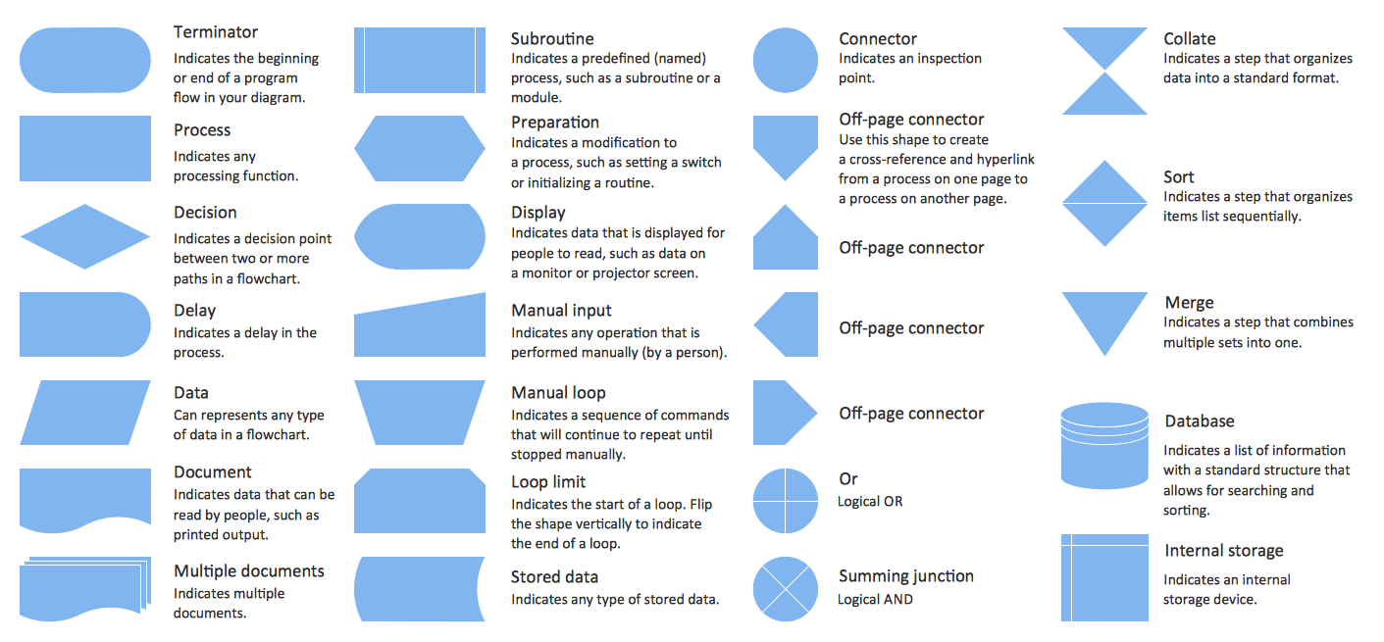

Slide 8
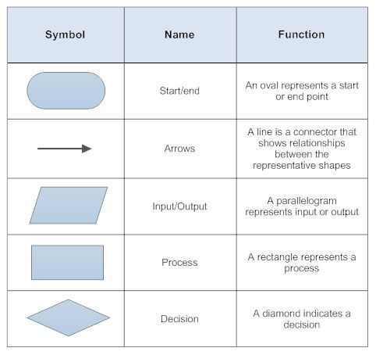
Basic Flowchart Symbols

Slide 9
Problem Solving Exercise: Simple Addition
Create a simple program to add two number and display the sum. You are required to design the right algorithm and the relevant flowchart for this problem.

Slide 10
Problem Solving Exercise: Comparison basics
Create a simple program to read a number from your user. Your program should be able to identify if it is negative, positive or zero. You are required to design the right algorithm and the relevant flowchart for this problem.

Slide 11
Problem Solving Exercise : Multiple Comparison
Create a simple program to read three numbers from the user and identify which one is the largest. You are required to design the right algorithm and the relevant flowchart for this problem.

Slide 12
Problem Solving Exercise : Modulo division
Create a simple program to read a number from the user and identify if the number is even or odd. You are required to design the right algorithm and the relevant flowchart for this problem.

Slide 13
Problem Solving Exercise : Simple Interest
Create a simple program to read the principal, time and rate, for which your program should calculate the Simple Interest. You are required to design the right algorithm and the relevant flowchart for this problem.

Slide 14
Problem Solving Exercise : Swap values
Create a simple program to read two numbers from the user. You are required to swap the values of the variables. You are required to design the right algorithm and the relevant flowchart for this problem.

Slide 15
Problem Solving Exercise : Simple Interest
Create a simple program to read a number from the user. Based on the number given, your program should give which day of the week it is. You are required to design the right algorithm and the relevant flowchart for this problem.

Slide 16
Problem Solving Exercise : Brainstorming
You are required to design a vote counting machine. It is to find the winner of a local election. The election has 4 candidates, namely C0,C1,C2 and C3 (the names have been hidden). For each vote received by the candidate, you are to maintain a count and when all votes are counted, your program should declare the winner. It should identify the winner with total votes he/she got, total count of invalid votes and the total voter turn-over of the election.
Additional, your should show the vote count of each candidate in descending (or ascending order)

Slide 17
Thank You!
We have done the basics!

